Slide 1
DocScribe
An AI Assistant for medical professionals

Slide 2
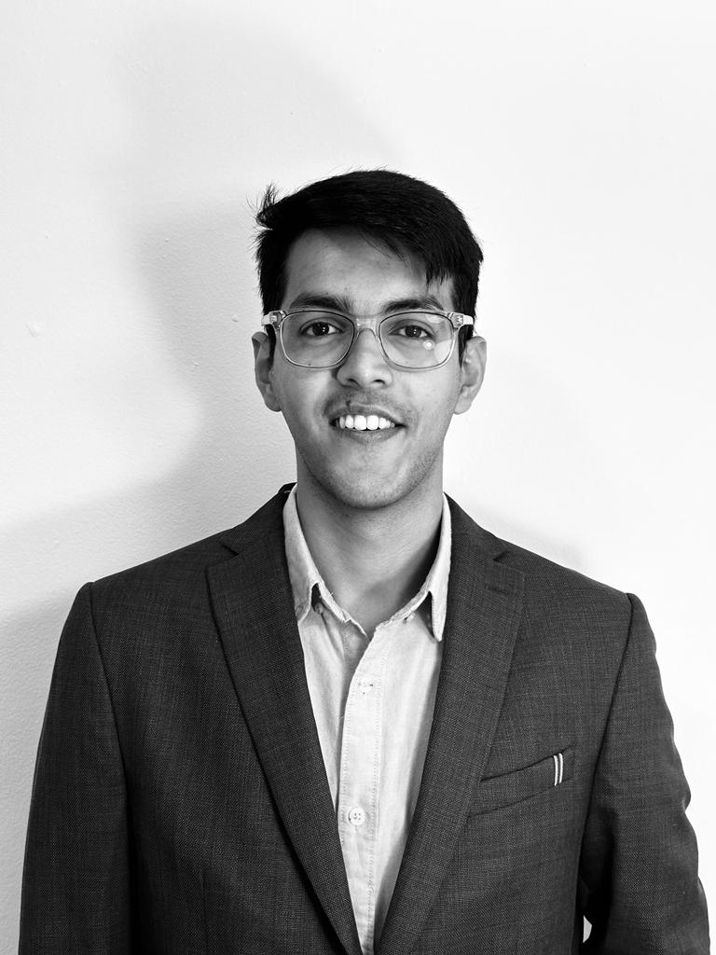
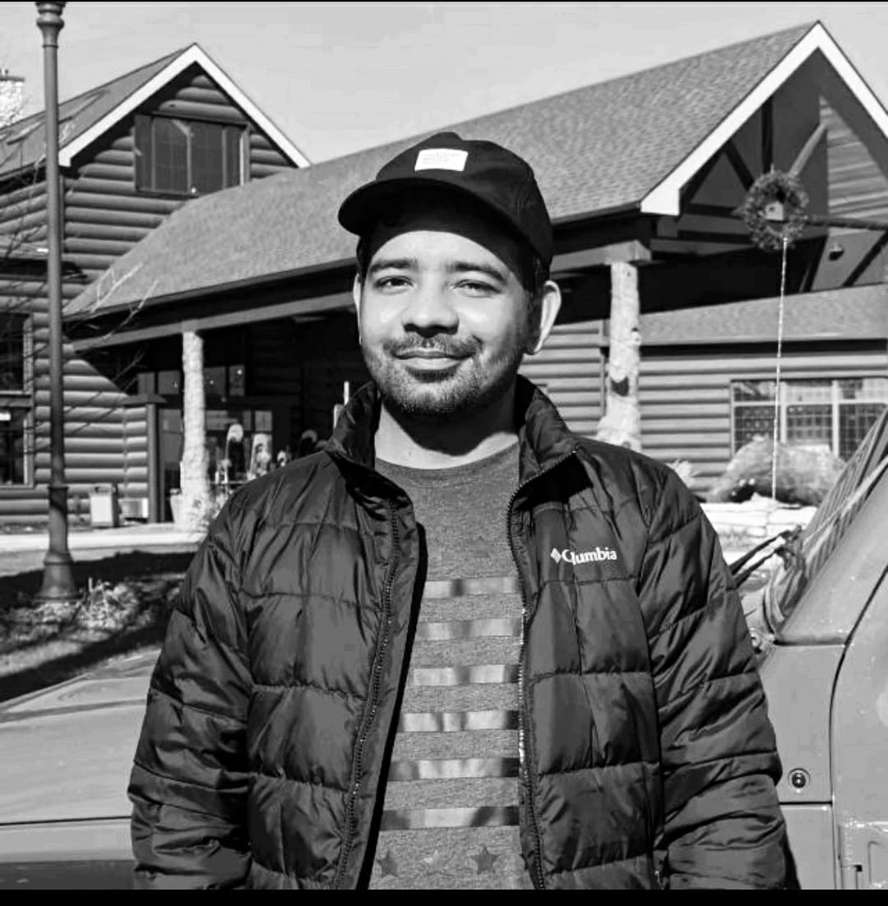

OUR TEAM
Manish Kumar
Ekansh Trivedi
Kargil Thakur
mnis@uchicago.edu
ekansh@uchicago.edu
kargil@uchicago.edu

Slide 3

INTRODUCTION
We aim to develop a medical QA chatbot that can respond quickly and accurately to general medical and patient-specific queries

Slide 4
TABLE OF CONTENTS
01
05
02
06
Objectives
Architecture
Results
Data Sources & Data Samples
07
Conclusions
03
Live Demo
Modeling Approach
04
08
Recommendations & Future Work

Slide 5

OBJECTIVES
Patient History Retrieval
Report Summarization
Interact with medical transcripts
Extract insights based on patient history
Summarize reports from multiple visits
Identify relevant information
DocScribe
Medical QnA
Transcribe Medical Reports
Ask general medical queries
Learn about drug interactions, medical conditions, etc.
Convert patient medical report into a more accessible format
Making it easier to interpret data from Medical Reports

Slide 6
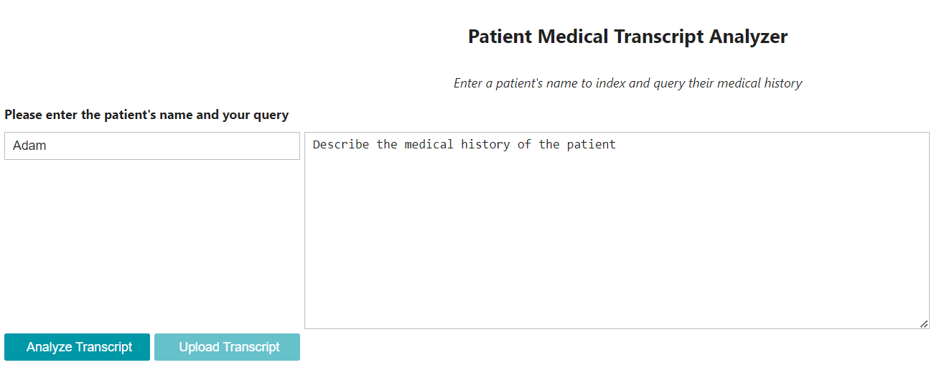
Live Demo

Slide 7
DATA SOURCES
Medical Transcripts | WikiDoc | WikiPatient
We leveraged GPT-3.5 model to generate 4.5k QA prompts from the medical transcripts (MTSamples dataset) | WikiDoc is a platform for medical professionals to contribute and edit medical content 10k QnA prompts | WikiPatient a platform for patients to access information and education about diseases 5k QnA prompts

Slide 8
MODELING APPROACH
Approach:
Model: Fine-tuning Vicuna-13B
Training: LoRA, PEFT, bitsandbytes
Hyperparameters: Same as Alpaca
Frameworks:
LLM Components: LangChain
Weights: HuggingFace
Training: PyTorch
Embeddings: all-mpnet-base-v2
Vector database: Qdrant

Slide 9
ARCHITECTURE
Upload Report
Web UI
Return Answer
Create embeddings
Embed user question
Fetch relevant text from transcripts
Generate Answer
Create Index
Calculate similarities
Ask LLM

Slide 10
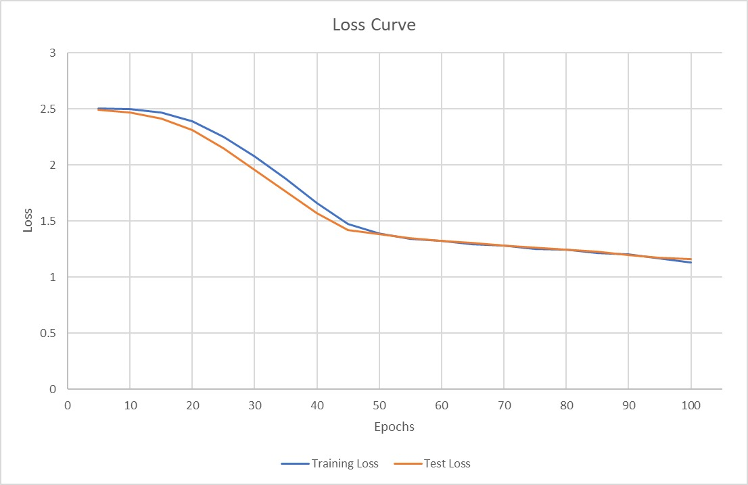
RESULTS
Training Loss vs Testing Loss
Our model has successfully achieved its objectives of extracting patient information, generating report summaries, and answering general medical questions
The decrease in train and test loss indicates that the model is learning and improving with each training epoch and is a great sign, suggesting the model is balanced

Slide 11

FUTURE WORK
MODEL IMPROVEMENT
RESEARCH
Training base model On medical corpus and
Incorporate Human Feedback
Explore the use of the medical LLM for research and clinical trials
and include medical image analysis

Slide 12
THANK YOU!

Slide 13

RESOURCES
Wikidoc - https://huggingface.co/datasets/medalpaca/medical_meadow_wikidoc
WikiPatient - https://huggingface.co/datasets/medalpaca/medical_meadow_wikidoc_patient_information
Vicuna - https://huggingface.co/lmsys/vicuna-13b-delta-v0
LangChain - https://github.com/hwchase17/langchain
Llama - https://huggingface.co/docs/transformers/main/model_doc/llama

Slide 14
APPENDIX

Slide 15
DATA SAMPLES
Dataset | Instruction | Input | Output
WikiDoc | Answer this question truthfully | Can you provide an overview of the lung's squamous cell carcinoma? | Squamous cell carcinoma of the lung may be classified according to the WHO histological classification system into 4 main types: papillary, clear cell, small cell, and basaloid.
WikiPatient | Answer this question truthfully | When to seek urgent medical care when I have Alstrom syndrome ? | Call your healthcare provider if you or your child have symptoms of diabetes such as increased thirst and urination. Seek medical attention promptly if you think that your child cannot see or hear normally.
MT Samples ( Self – generated) | Based on the given medical transcript, generate prompt and answer to train LLM | What was the patient's preoperative diagnosis? | The patient's preoperative diagnosis was prostate cancer.

Slide 16
MODELING APPROACH
Model Justification:
Explored the following open-source models:
We decided to go ahead with Vicuna (13B params)
This decision was based on a manual analysis of model results and online reviews and posts regarding the different models and the computational costs of each
Alpaca
Dolly
Vicuna 7B
Vicuna 13B

Slide 17
DATA & MODELING LIMITATIONS
Prompt Generated from OpenAI GPT3.5 model –
No quality check on the data. There might be some irregularities between question and response.
Vicuna model -
Base LLM model not trained on domain specific medical corpus.
Vicuna, like other large language models, has limitations in tasks involving reasoning.
It may also struggle with accurately identifying itself or ensuring the factual accuracy of its outputs.
Vicuna has not been sufficiently optimized for safety, toxicity, or bias mitigation.

Slide 18
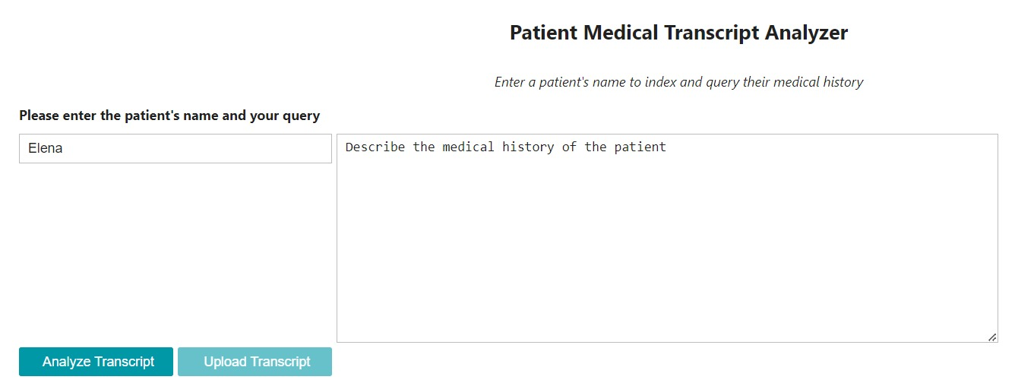
TRANSCRIPT ANALYZER INPUT
Input for the transcript analyzer is the name of the patient and question related to its transcript.

Slide 19
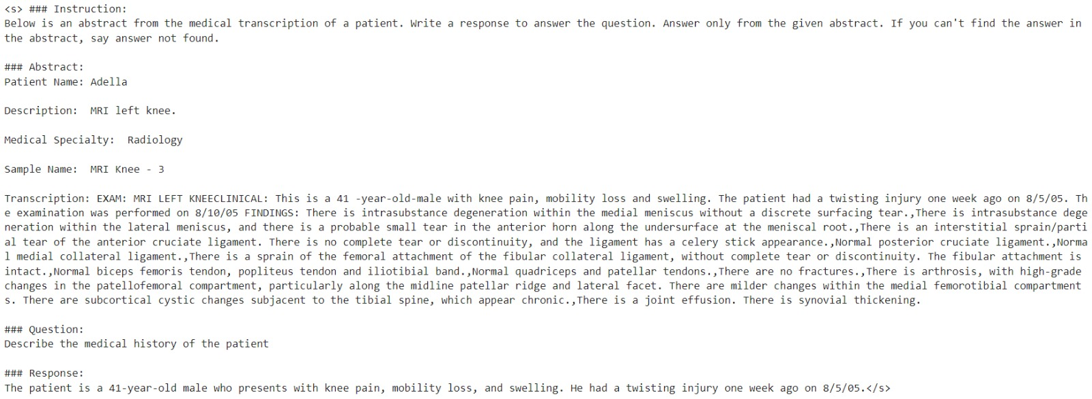
TRANSCRIPT ANALYZER OUTPUT
Output for the transcript analyzer is a response to transcript specific question to the LLM.

Slide 20
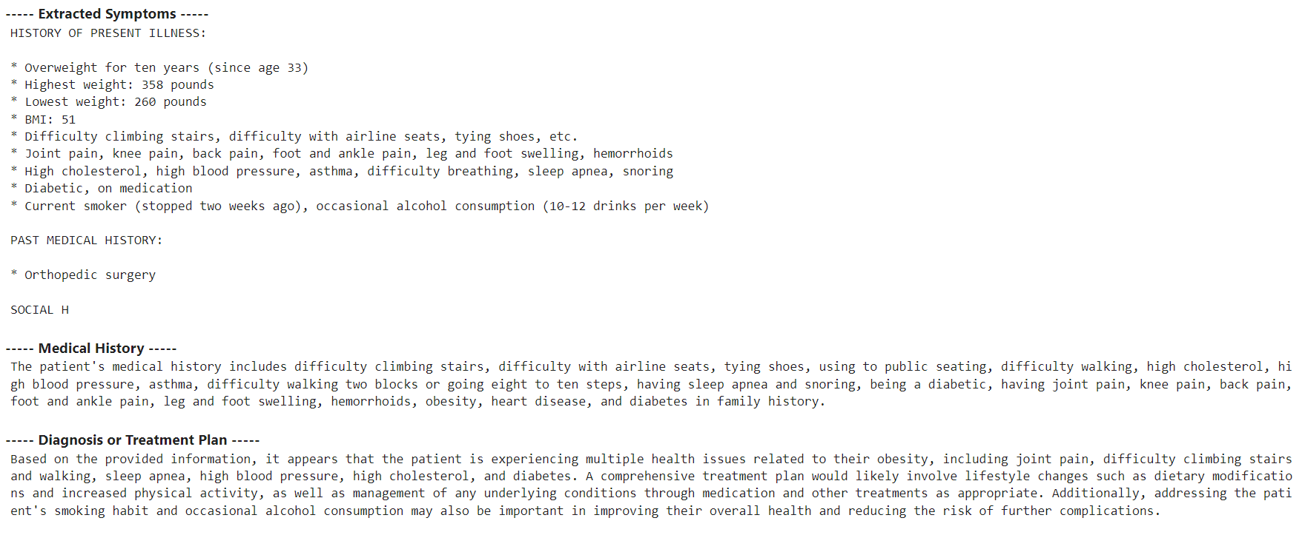
DIAGNOSIS OR TREATMENT PLAN

Slide 21
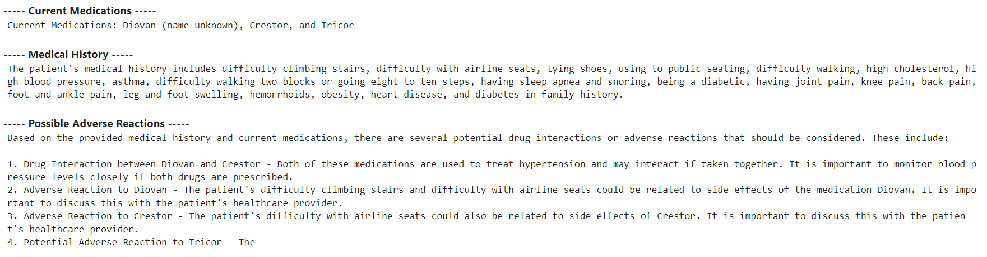
POTENTIAL ADVERSE REACTIONS

Slide 22
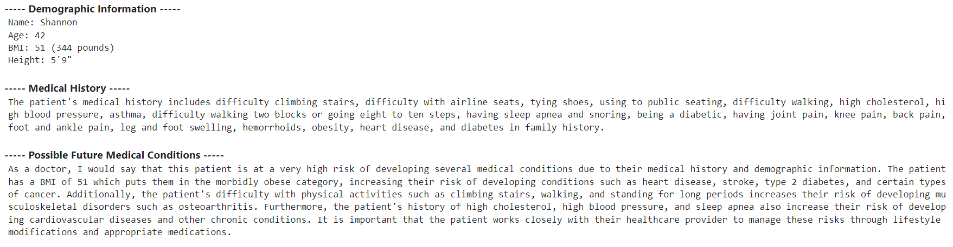
POTENTIAL FUTURE MEDICAL CONDITIONS

Slide 23
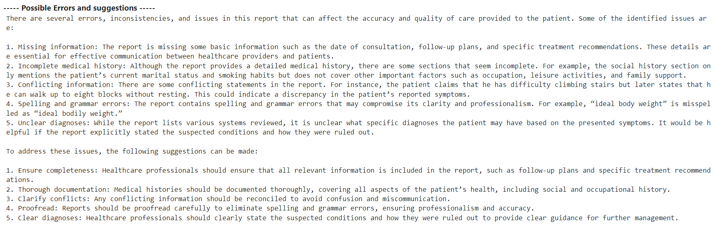
FINDING ISSUES IN THE REPORT

Slide 24
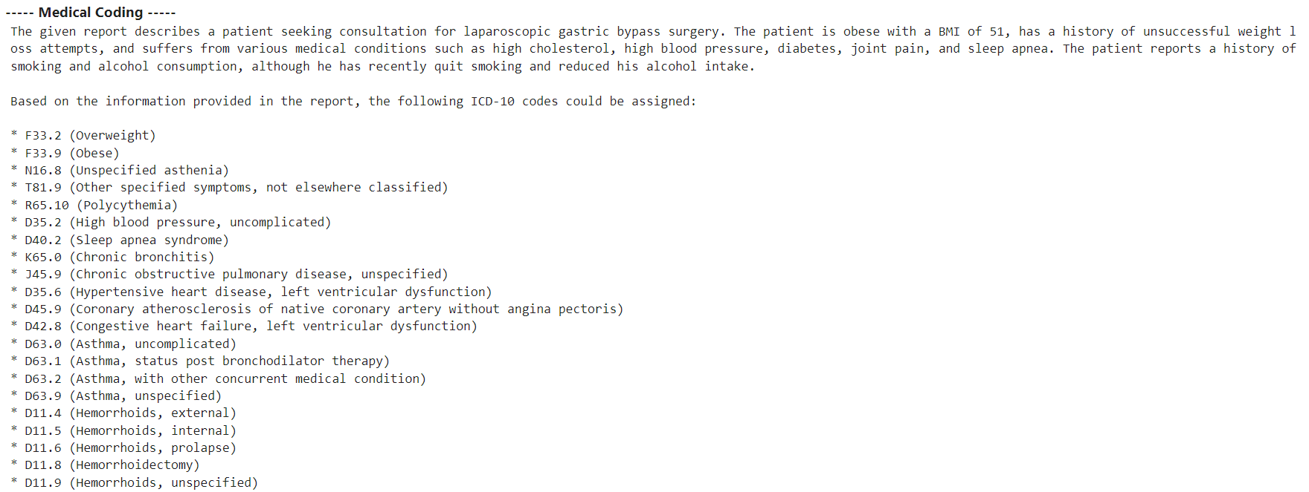
AUTOMATIC MEDICAL CODING

Slide 25
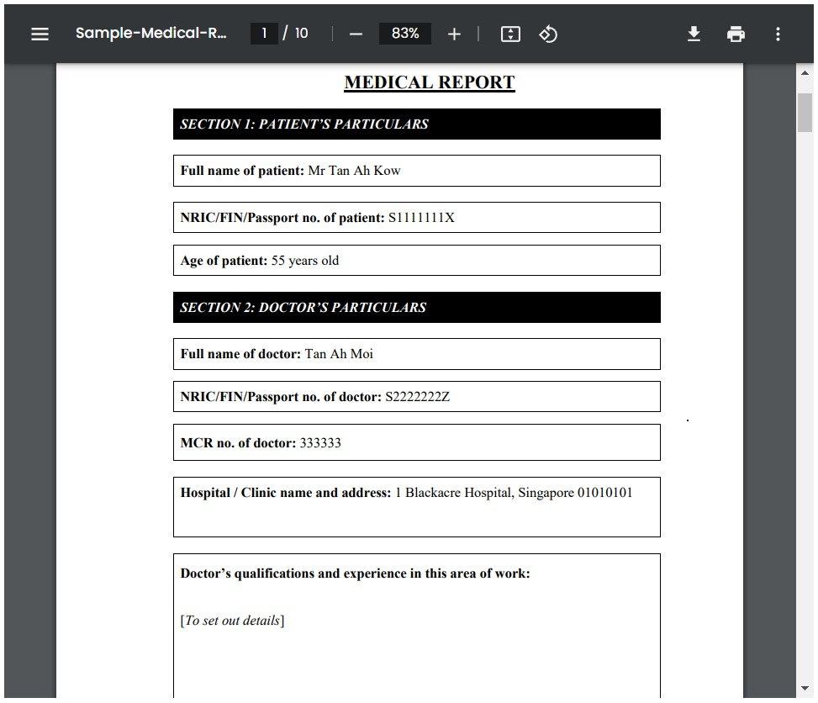
PDF PARSER INPUT
Input for the pdf parser is an unstructured pdf medical record.

Slide 26
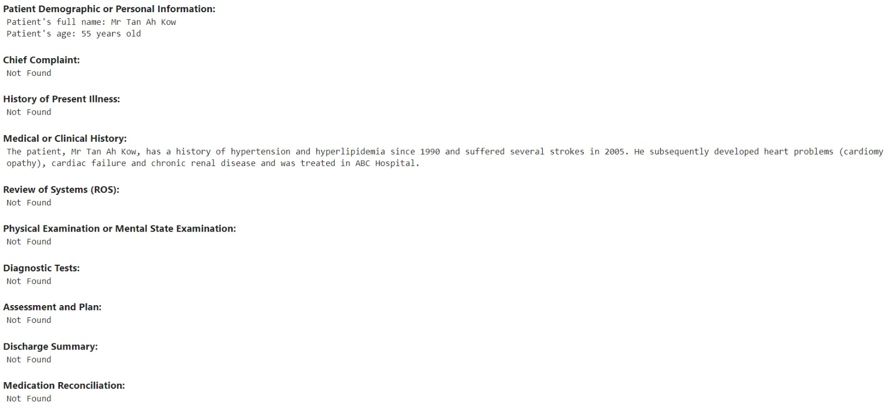
PDF PARSER OUTPUT
Output for the pdf parser is a structured health record with patient history, and demographics separated.

Slide 27
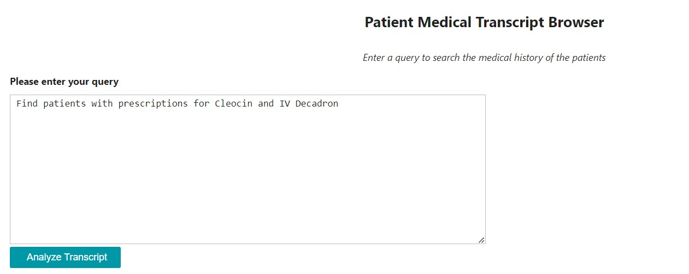
GENERAL MEDICAL QA INPUT
Input any medical query which is answerable from the transcripts.

Slide 28
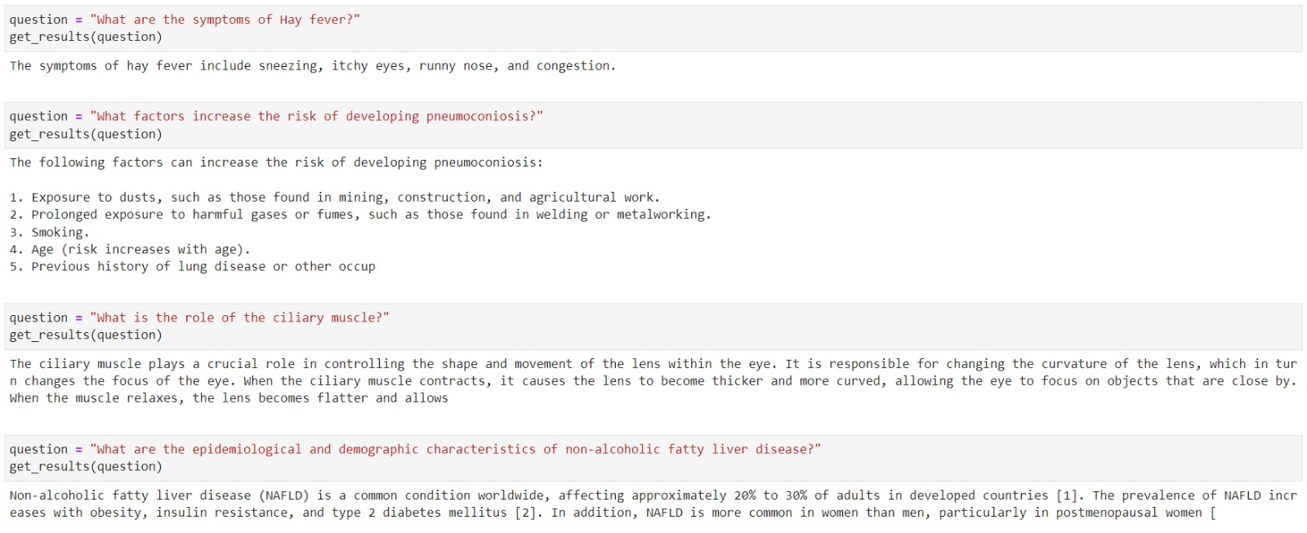
GENERAL INFERENCE OF MODEL

Slide 29
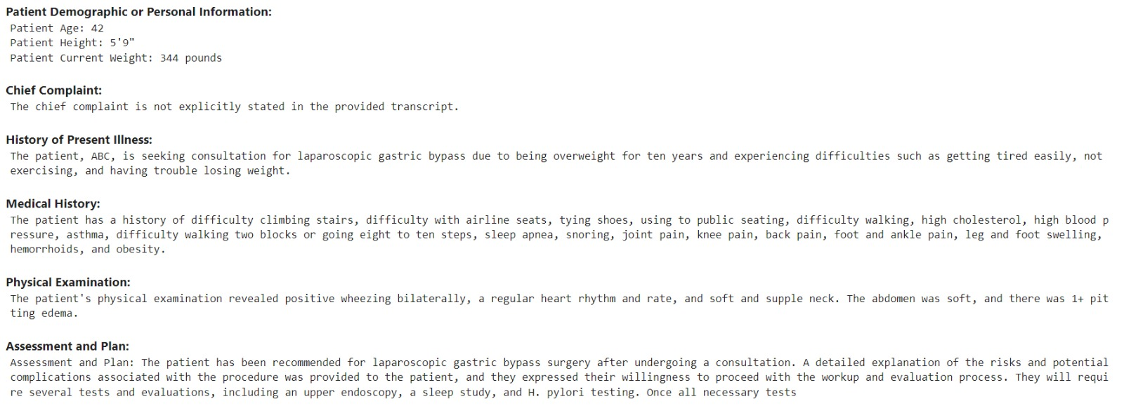
REPORT SUMMARIZER OUTPUT
Output for asking the LLM to summarize the report.

